Slide 1
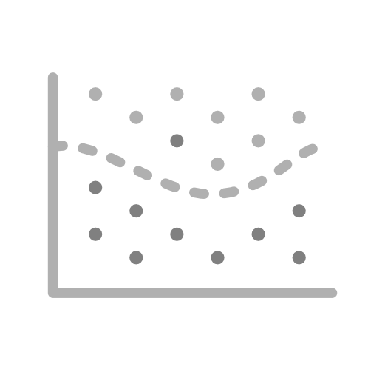
CSE 163
Machine Learning
Hunter Schafer

Slide 2
Cats vs Dogs
Congrats! You have just been hired to work at Twitter as a data scientist to answer the age-old question:
Are cats or dogs the best?
Given access to all the tweets, how might you tell?
cats = []
dogs = []
for tweet in tweets:
if 'dog' in tweet:
dogs.append(tweet)
elif 'cat' in tweet:
cats.append(tweet)

Slide 3
Cats vs Dogs
The job market is good for data scientists specializing in cats-vs-dogs, so you leave Twitter to go work for Instagram
Given access to all of the images, can we do the same?
cats = []
dogs = []
for pic in pictures:
if dog in pic:
dogs.append(pic)
elif cat in pic:
cats.append(pic)

Slide 4
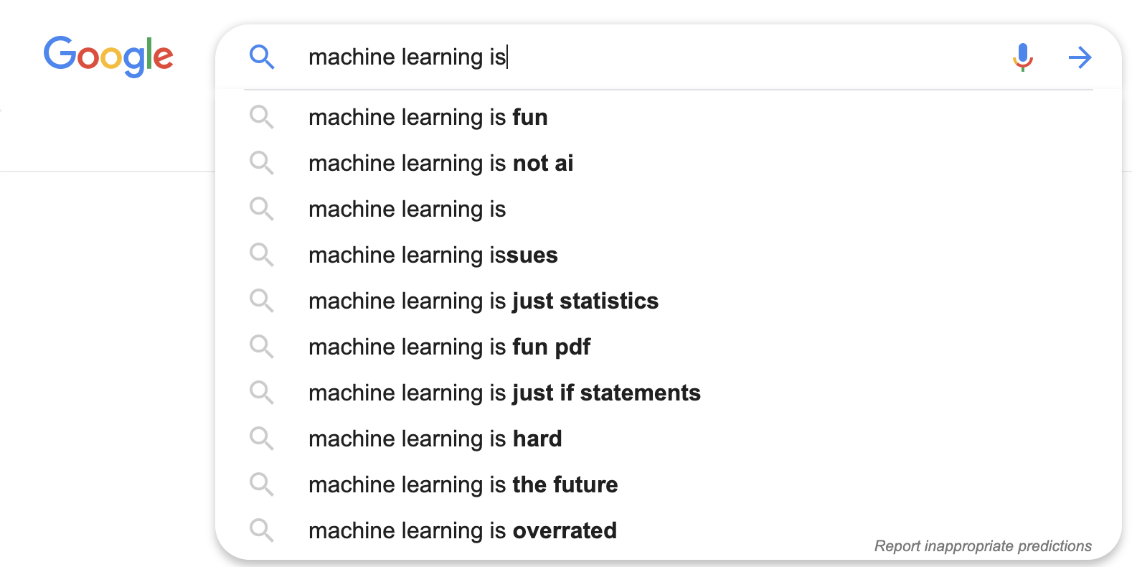
Machine Learning
What is Machine Learning?

Slide 5
Machine Learning
“A computer program is said to learn from experience E with respect to some class of tasks T and performance measure P if its performance at tasks in T, as measured by P, improves with experience E.”
Normal words: Uses data to automatically improve itself

Slide 6
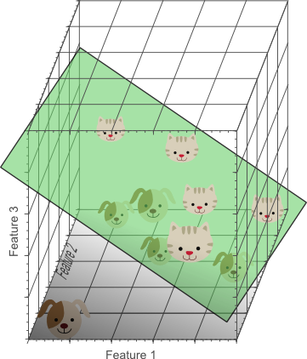
Learn Rules from Data
Learn rules automatically from data, rather than programming
We define features of our data that a model learns from to predict the label. We must learn this from a dataset, but the goal is to perform well on future, unseen data.

Slide 7
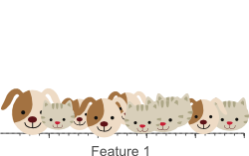
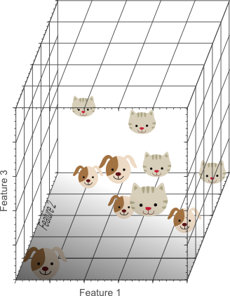
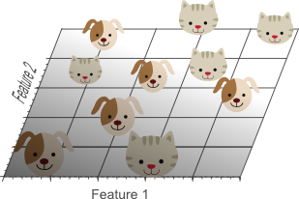
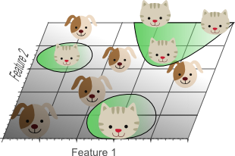
Features Matter
There exists hundreds of different model types, but the most important thing is having good features to describe your data
Garbage In => Garbage Out

Slide 8
Categorizing ML
Supervised / Unsupervised
Do you have to give the model labelled data to correct itself or can it do everything on its own?
Regression / Classification / Recommendation
What you are trying to predict changes what models you use
Regression - Predicting a real number (price)
Classification - Predicting a category (cat or dog)
Recommendation - What movie should you watch next?
In lecture today, we will be focused on classification and your homework deals with regression

Slide 9
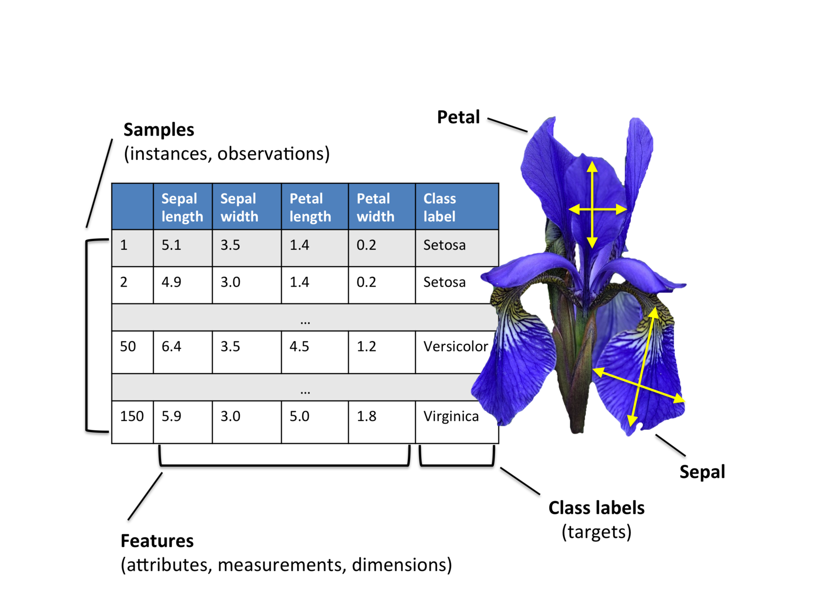
Iris Classification
Demo

Slide 10
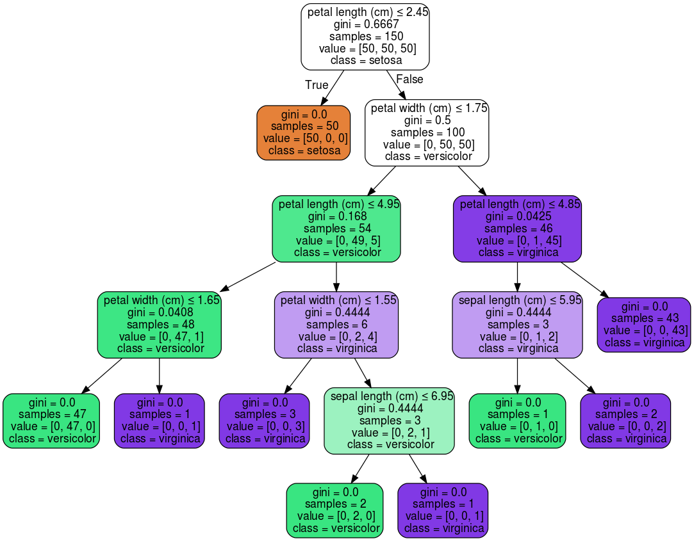
Decision Tree

Slide 11
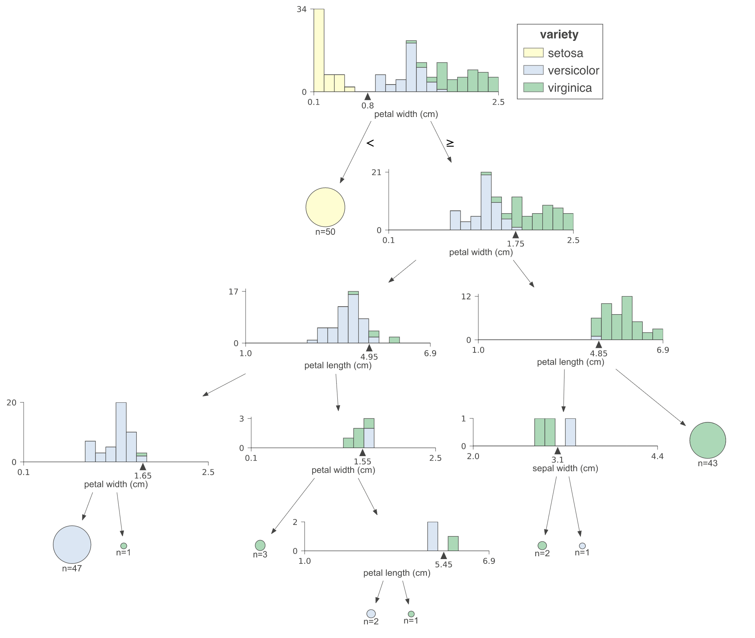
Tree Splits

Slide 12
1 min
What would you predict for a flower with
sepal length = 4 sepal width = 2
petal length = 5 petal width = 1.7

Slide 13
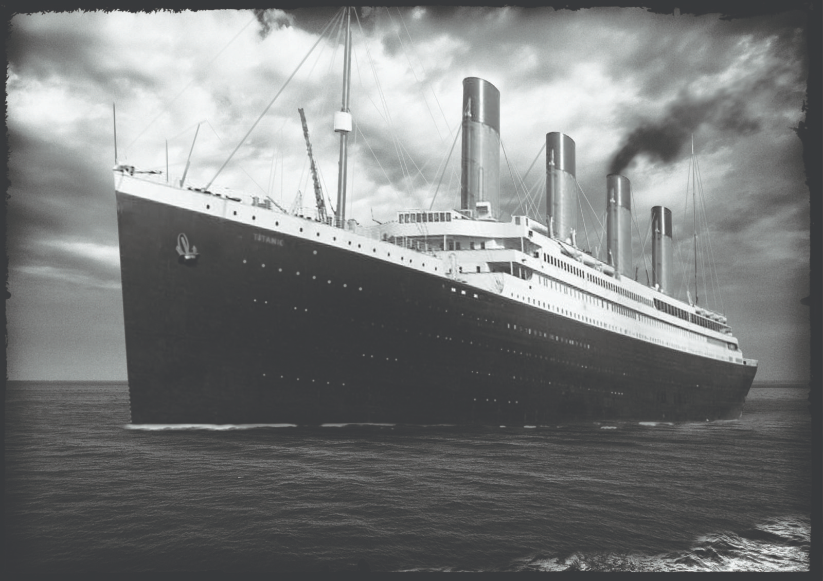
Titanic
Demo

Slide 14
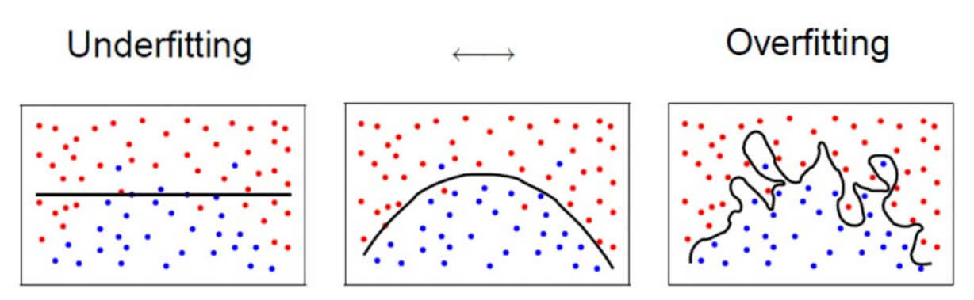
Evaluating Models
Which model is best?
Reminder we want a model that will perform best on future data

Slide 15
Overfitting
The most important problem in science you’ve never heard of
Overfitting: When your model matches the training set so well, that it fails to generalize
Memorizing answers to Multiple Choice test
Tall trees are likely to overfit if you don’t have enough data
Can learn very complex boundaries
Very few points at the leaves

Slide 16
Evaluating Models
Training is cool, but we want to know its future performance
Training data can’t be used to evaluate model
“I got 100% on the practice test I have been studying for 4 hours, therefore I will get 100% on the exam”
Must hold out data called a test set to evaluate at the end
Unbiased estimate of performance in the wild
Never ever ever train or make decisions based on your test set.
If you do, it will no longer be good estimate of future performance.

Slide 17
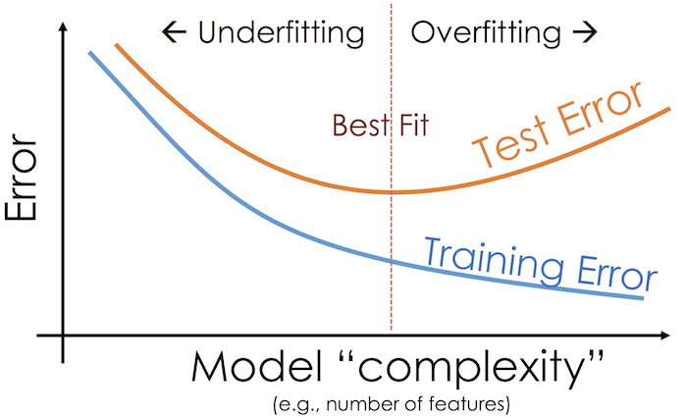
Model Complexity
Note this is error, not accuracy (error = 1 - accuracy)

Slide 18
Recap
The important ideas
Machine Learning
Features and labels
String features have to be treated specially
Models: Decision Tree
Training
Evaluating Model: Training accuracy vs test accuracy
Overfitting
Hyperparameter to change complexity (max height)
Scikit-learn (sklearn)
tree.DecisionTreeClassifier()
.fit(data, label) and .predict(data)
metrics.accuracy_score(y_true, y_pred)
model_selection.train_test_split(X, y, test_size)

